Slide 1
Fuzzy Testing
David Jefts
SE-625 – SOFTWARE QUALITY ENGINEERING AND ASSURANCE
EMBRY RIDDLE AERONAUTICAL UNIVERSITY

Slide 2
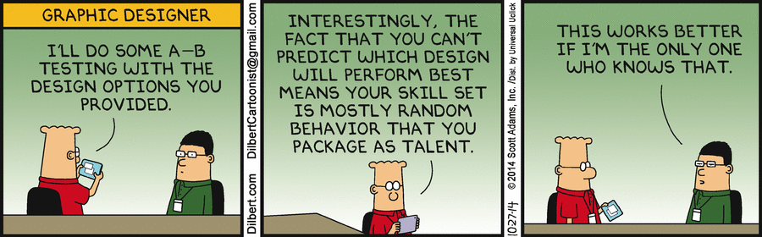

Slide 3
Agenda
Types of software testing
What is fuzzy testing?
Applications of fuzzy testing
Examples of Fuzzers and what they have discovered
Fuzzy testing compared to other testing methods
Making a case for fuzzy testing
Questions

Slide 4

Types of software testing
White-Box Testing
Black-Box Testing
Grey-Box Testing
Assertion-Based Testing
Fuzzy Testing

Slide 5
White-Box Testing
AKA Structural Testing
Testing with knowledge of internal software
Finding inputs to test 100% of code is expensive
Automated generators find inputs to execute specific lines of code
Random
Path-Oriented
Goal-Oriented
Higher time and monetary cost than Black Box testing

Slide 6
Black-Box Testing
AKA Functional Testing
Testers are oblivious of source code
Only test software through user-provided interface
Test data/cases generated based on testing
Class equivalency
Boundary-value analysis
Cause-effect graphing
Easy to randomize
May not uncover all program faults

Slide 7
Grey-Box Testing
Combination of White- and Black-Box testing
Testing based on
Internal algorithms
Internal system interactions
Offers clear distinction between developer and tester
Requires some pre-existing knowledge of system
Not easily automated

Slide 8
Assertion-Based Testing
Based on creating many “assertions” that represent program constraints
When one fails the program has a defect
Supported by default in many languages
Easy to generate assertions:
Boundary checks
Division by zero
Null pointers
Variable over- and under-flow
Generating large amounts of assertions is often impractical
Often difficult to find inputs to pass through all assertions
Completely manual testing
Positive and negative testing paradigm

Slide 9
Fuzzy Testing
AKA Brute-Force Testing
Process of submitting malformed, malicious, and random data to program to uncover faults
Designed to be automated
Data generation can use genetic algorithms
Negative testing paradigm
Cheapest and easiest form of testing
Extremely fast input generation
Does not guarantee full code coverage due to the halting problem

Slide 10

Input Case Testing
Edge Cases
Extreme operation parameters
Corner Cases
Outside normal operation parameters
Boundary Cases
Beyond maximum parameters

Slide 11
Fuzzy Testing
Similar to stress testing
All fuzzers include:
Data generation
Data transmission
Target monitoring and logging
Automation
Data can be generated in multiple ways:
Randomly
Brute-Force
Data mutation

Slide 12
Applications of Fuzzy Testing
Exposing software bugs and defects
Discovering security vulnerabilities
Online system exploitation
Generating malicious data

Slide 13

The Monkey
Developed in 1983
Used on Macintosh computers
Used journaling hooks to feed random events to the current application
Simulated an angry monkey randomly pounding on the keyboard and mouse
Very rapid data generation

Slide 14


PROTOS
Security Testing of Protocol Implementations
Joint effort of The University of Oulu and VTT Electronics
Used to find vulnerabilities in:
Cisco Routers running Cisco IOS
AdventNet Web NMS 2.3
IBM SecureWay on Solaris and Windows 2000,
Qualcomm Eudora WorldMail for Windows NT

Slide 15


SMUDGE
Software Mutilation Utility and Data Generation Engine
Written in Python to perform network protocol fuzzing
Used to:
Break the Sambar Web Server
Cause DoS in Helix Servers
Find overflows in Internet Explorer

Slide 16

FDA
The U.S. Food and Drug Administration implemented fuzzy testing
Used to test the security of its cybersecurity laboratory in 2014
Used Defensics

Slide 17
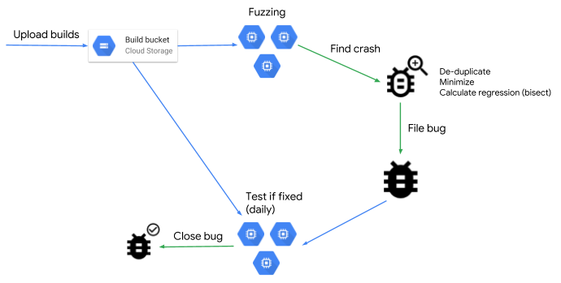

ClusterFuzz
Fuzzy Testing Tool Developed by Google
Cloud-Based
Used initially to test Google Chromium and Google Chrome
Highly Scalable
Open source

Slide 18

Heartbleed
Security vulnerability in the OpenSSL cryptographic software library
Used to reveal the memory of systems normally protected by SSL/TLS to anyone

Slide 19

GOD MODE UNLOCKED
Hardware backdoor in x86 CPUs
Discovered July 2018 by Christopher Domas
Offers ring 3 (userland) to ring 0 (kernel) privilege escalation

Slide 20
Comparison
Fuzzy Testing Data Generation Paradigms
Random Data Generation
Brute-Force Data Generation
Data Mutation
Smart vs Dumb Fuzzing
Fuzzy Testing vs Static Analysis

Slide 21
Data Generation
Random Generation
Lowest effort
Requires no software infrastructure knowledge
Does not guarantee finding all bugs
Brute-Force
Sequential data generation
Highest storage and time requirement
Guarantees finding all possible inputs
Terrible efficiency
Data Mutation
Minimal required effort and knowledge
Poor code coverage and efficiency

Slide 22
Smart and Dumb Fuzzing
Dumb Fuzzing
Similar to Data Mutation
Wide variance of effectiveness
Smart Fuzzing
Generating test data using protocol and software description
Long time to create test inputs
Executes 2-5 times more code

Slide 23
Fuzzy Testing vs Static Analysis
Fuzzy Testing
Required no code knowledge
Produces demonstrable exploits with minimal effort
Incomplete exploit coverage
Much faster
Static Analysis
More thorough
Does not require running source code
Can find errors hidden by error handling and processing

Slide 24
Why Fuzzy Testing?
Large variability
Small implementation time
Completely automated
Should be implemented in every software development life cycle

Slide 25
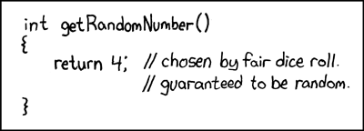
Questions
Generating random numbers and inputs

